Slide 1
Past Perfect

Slide 2
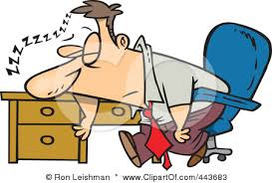
Past Perfect For an event that occurred before another event in the past.
He was sleeping in the office
He was sleeping in the office because he had had a terrible night.

Slide 3
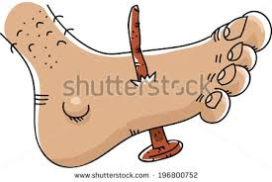
Past Perfect For an event that occurred before another event in the past.
David was jumping barefeet
David was jumping barefeet and someone had left a nail in the floor, so his foot got injured.
David was jumping barefeet and someone had left a nail in the floor, so his foot got injured.

Slide 4
Formula
Sub
had
Past part
He
had
had a terrible night
had a terrible night
Someone
had
left a nail on the floor
left a nail on the floor

Slide 5
The other day I couldn´t get into my house because I had forgotten the keys in the office.
The other day I couldn´t get into my house because I had forgotten the keys in the office.
The other day I couldn´t get into my house because I had forgotten the keys in the office.
Sub
had
Past part
(forget)
(forget)

Slide 6
Luis was feeling sick and his girlfriends asked him if he had gone to the doctor.
Luis was feeling sick and his girlfriends asked him if he had gone to the doctor.
Luis was feeling sick and his girlfriends asked him if he had gone to the doctor.
Sub
had
Past part
(forget)
(go)
(go)

Slide 7
They crashed when they were coming from CUCEA´s welcome party due to the fact that the driver had drunk a lot.
They crashed when they were coming from CUCEA´s welcome party due to the fact that the driver had drunk a lot.
(crash)
(come)
(drink)

Slide 8
Two days ago my friend Samantha passed out because she hadn´t eaten anything in all day. It was very weird, we were talking and out of the sudden she fell down.
Two days ago my friend Samantha passed out because she hadn´t eaten anything in all day. It was very weird, we were talking and out of the sudden she fell down.
(pass)
(not eat)
(talk)
(fall)

