Slide 1
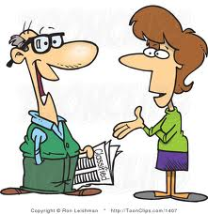
Indirect requests
Can you ask dad if he still needs me to buy new tires?
Lucy wants to know if you still need her to buy new tires?
Tell Lucy I don´t feel tired!!!
Sure!!!

Slide 2
Statements
Could you tell Rose (that) Tony is having a party?
Rose
”Tony is having a party”
Johny
“People are going crazy”
Can you tell Johny (that) people are goingcrazy?

Slide 3
Imperatives
Petrita
“Don`t be late”
Would you tell Petrita not to be late?
Chuchita
“Stop eating”
Can you tell Chuchita to stop eating?

Slide 4
Yes/No questions
Sinforoso
“Are you free on Friday?”
Could you ask Sinforoso if he´s free on Friday?
Could you ask Sinforoso if is he free on Friday?
Sophie
“Do you have my number?”
Would you ask her whether or not she has my number?

Slide 5
Wh-questions
Can you ask David when the party starts?
David
“When does the party start?”
Can you ask David when does the party start?
Kermet
“Where should I pick you up?”
Would you ask Kermet where I should pick him up?

Slide 6
Remember !! We use Indirect requests to:
-Tell someone to do something.
-Ask someone to do something.
-Ask someone for some information.

