Slide 1
Relative Clauses

Slide 2
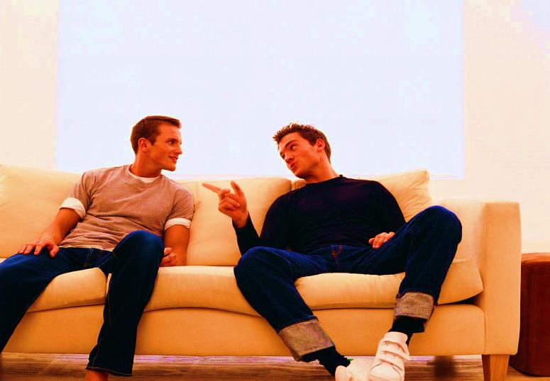
Relative Clauses We use relative clauses to give additional information about something without starting another sentence.
I asked out the girl who I saw yesterday.
I asked out the girl who I saw yesterday.
I asked out the girl who I saw yesterday.
Dude…I saw a beautiful girl in the gym today.
I asked out a girl. The girl I saw yesterday in the gym

Slide 3
Relative Clauses We use relative clauses to give additional information about something without starting another sentence.
I had the most boring date with a guy.
The guy I told you yesterday.
I had a boring date with the guy who I told you yesterday.
I had a boring date with the guy who I told you yesterday.
I had a boring date with the guy who I told you yesterday.
I had a boring date with the guy that I told you about yesterday.
What guy?
A guy from the gym asked me out!!

Slide 4
To join both sentences we use “RELATIVE PRONOUNS”: who, that, which, whose
Who: people
Which: things
That:
People or things
(informal)
Whose:
possession

Slide 5
More examples:
I got a new car.
My new car has an amazing audio system.
I got a new car which/that has an excellent audio system.
I got a new car which has an excellent audio system.
I have a friend called Miriam.
Miriam´s husband is a drug dealer.
I have a friend called Miriam whose husband is a drug diller.
I have a friend called Miriam whose husband is a drug dealer.
I have a friend called Miriam
that husband is a drug diller.

Slide 6
More examples:
Humberto works in my office.
I met Humberto in High school.
In the middle
Humberto who I met in High school, works in my office.
My mom is the best person in the world.
My mom´s chancla used to fly all over the house.
My mom,whose chancla used to fly all over the house, is the best person in the world..

Slide 7
Roberto is working on a new project
He has been planning this project for a year.
Roberto is working on a new project that he´s been planning for a year.

Slide 8
They fixed a computer.
This computer got broken 2 months ago.
They fixed a computer that got broken 2 months ago.

Slide 9
Rose will study Mandarin.
Mandarin is one of the most difficult languages.
Rose will study Mandarin,which is one of the most difficult languages.

Slide 10
I´m going to go to Cancun.
Cancun has the best clubs.
I´m going to go to Cancun,which has the best clubs.

Slide 11
In the middle
Enrique Peña Nieto is the president of Mexico.
Enrique Peña Nieto never reads books.
Enrique Peña Nieto, who never reads books ,is the president of Mexico.

Slide 12
In the middle
Marc Antony is an excellent singer.
JLO was Marc Antony´s wife.
Marc Antony,whose wife was JLO, is an excellent singer.

Slide 13
In the middle
Paquita la del Barrio sings “Rat of two feet”.
Paquita la del Barrio is similar to my mother-in-law.
Paquita la del Barrio, who is similar to my mother-in-law, sings “Rat of two feet”.

